Slide 1




Intelligent End-To-End Traffic Congestion Trouble Shooting – using P4
Staff : Itzik Ashkenazi, Alan Lo
Students : May Elbaz, Adi Sharon
Notes:
HI All
My name is May – I’m a student in the 4-year bioinformatics programs in computer science faculty
Im Adi- im in the three-years computer science program
We are here today to presents our computer communication and networking project with Mellanox technologies –
Intelligent end to end traffic congestion trouble shooting using p4
With our construcrtors- Itzik Askenazi from the LCCN and ALAN LO from Mellnaox

Slide 2

Motivation
As for now, there is no efficient way to identify the cause of network congestion in Real-time.
Switches are not always capable of providing the necessary information.
Troubleshooting such issues in order to find the root cause can be a difficult task.
Notes:
Imagine you’re managing one of Facebook or Google’s network infrastructures or data centers, but not having precise information for troubleshooting certain problems.
Data centers require real-time & precise feedback from their network equipment in order to make the troubleshooting process simpler and more effective.
But the trouble today with the standard switches in data centers, is that they do not offer a lot of information about the state of the traffic going through them, Which makes it difficult to pinpoint an exact source of the network’s performance issues.

Slide 3
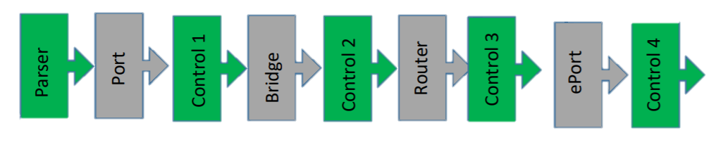
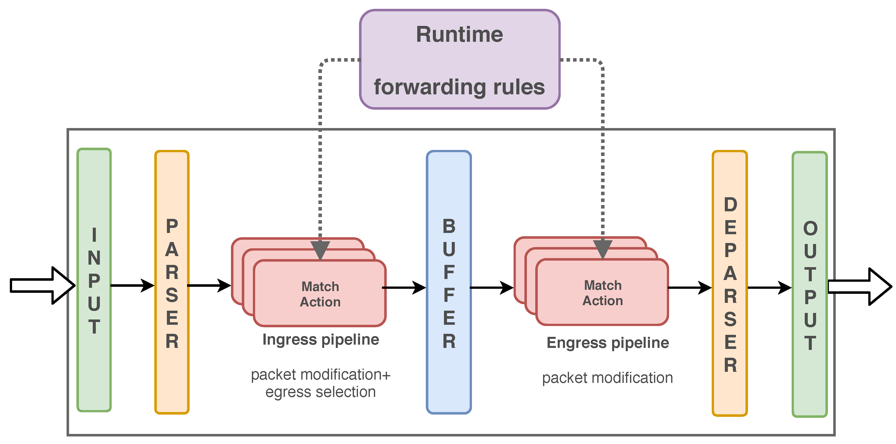

Background: P4 Language
Notes:
P4 is a new, highly advanced open-source programming language for controlling packet forwarding planes in networking devices, such as routers and switches.
This means at every stage of the switch’s forwarding pipeline, we can perform certain actions, that depend on the packet itself.
On upper image we can see the programmable blocks on a P4 capable switch. In our project, we used programmable block 5 (control 4) to insert our p4 code.
the Programmable block 5: egress port, has the Ability to define chain of multiple match action tables.
supported actions – drop, egress mirror, packet modifications, counters and so on .
P4 requires a compatible HW – a programmable switch or target, capable for P4 execution, such as spectrum SN3700
‘

Slide 4

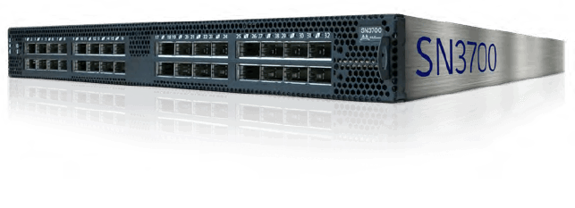
Background: Mellanox switch
Mellanox SN3700 Spectrum-2 based switches are advanced, intelligent switches,
capable of implementation and execution of P4 programs
SN3700 is a hybrid switch, giving the benefits of a legacy
switches, with the dynamic agility of the P4 language.
Notes:
the SN3700, is a high performance switch in the Spectrum-2 family.
SN3700 Is a hybrid switch, meaning, it can be dynamically updated and reprogrammed without requiring an ONYX version update for every change.
It also has the capability of a legacy switch, meaning that we don’t need to implement basic routing and switching ourselves.
The switch is capable of P4 programming and can use it’s dynamic features for the user’s benefits.

Slide 5

The solution
An intelligent End-To - End Traffic Congestion network debugger
Notes:
Every programmer’s best friend and worst enemy, is the debugger. It allows the user to troubleshoot the errors and malfunctions of a program. It’s a tool to see ‘what went wrong’ that is the most secure way to successfully achieve a solution. Our debugger is programmed to see the information flowing in the system and show the user where is the problem and who is at fault .
Our debugger uses the spectrum 2 switch’s capabilities and the P4 language strength and agility to provide the NW manager all the necessary information to solve the network’s problem.

Slide 6





steps
Sampling
Mirroring
Encapsulating
Analyzing
Presenting
Notes:
SAMPLING] We use the p4 programming language, to sample packets at a pre-defined rate, and this would be the first stage of the travelling packets going through our augmented switch. This way, we wouldn’t have to collect information through every single packet that goes through the switch, but only through a subset of them.
[MIRRORING] We could then mirror those sampled packets on to a collecting unit. Mirroring is taking packet going from one port in the switch to another, and transmit it, as a whole, to another port.
[GRE] Finally, we could wrap those mirrored packets with useful telemetric information. Mellanox’s Spectrum-2 support GRE, short for Generic Routing Encapsulation, a tunneling protocol developed by Cisco, that can encapsulate a wide variety of network layer protocols
Analyze – once holding all the necessary information and triggered by the user, experiencing congestion, the collector uses the mirrored information to analyze the source, destination, and other information arriving , separating wanted, user flows from congesting flows.
Present – The information collected and analyzed by the collector is shown in a user – friendly GUI that presents the info, including the user’s tuple, the congested port and the various flows that go through it

Slide 7

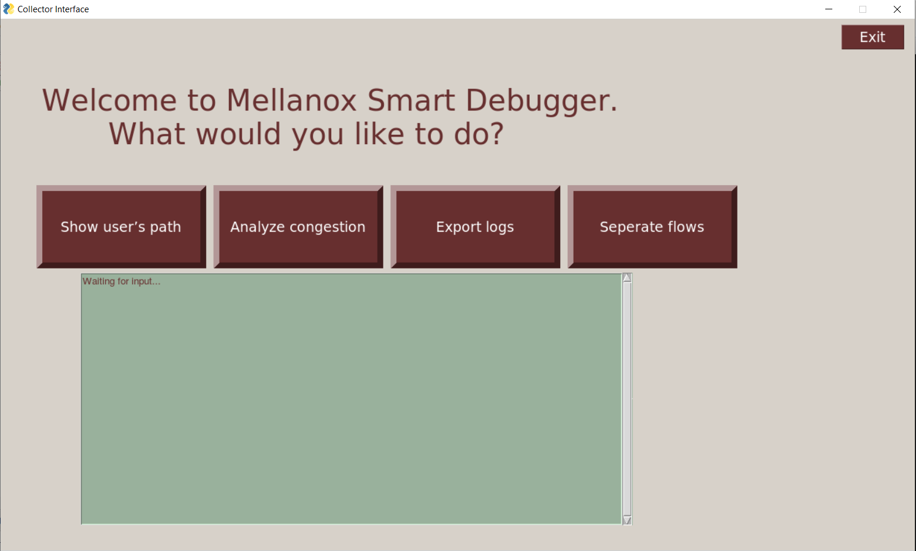
The Final outcome
Pinpoint on the congesting ports in the network (source, destination) and the user’s wanted flow.
A user-friendly method for network managers to obtain the information received
Notes:
The final outcome is friendly user method to show the user the information analyzed- who is the congesting port, where is the congestion coming from, where is it headed, and more information

Slide 8
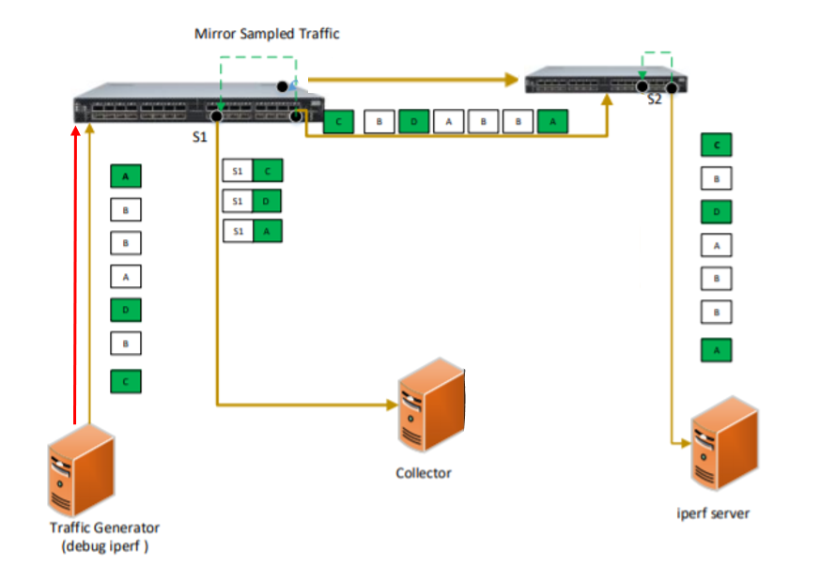
Set up
e
Notes:
Traffic generator – creates the traffic- both user and congesting
The application is triggered there to start sample packets
We used 2 python scripts here.
One is to mark the good user flow generated by iperf, using iptables which required us a lot of research. The script allows us to match by a specific application and dynamically add and remove rules.
The other script generates the congesting flow with scapy, sending high rate packets by demand
On the side we can see the Iperf server – other end of the user’s trafiic
Here is the Mellanox SN3700 switch on which we talked about before.
Our p4 program runs on this switch, updated dynamically using P4RT. The switch both forwards the packets to second switch and mirrors them the collector as well.
This is A spectrum 1 switch, which forwards the info to the iperf server.
Collector- doing all the ‘hard thinking’ of info analyzing and presenting results
Here we run a docker container holding a P4RT shell environment. The collector sniffs the mirrored packets, uses a script to deparse and analyze the encapsulated information. Further more , it establishes a connection to the switch using P4RT which allows it to add and modify table entries and – controlling the p4 program on the switch. It also presents the information in a friendly fashion.
While there are two connections between the switches, our programs identifies the problematic port, and creates a specific match action using p4runtime in order to analyze exactly who is congesting this port.

Slide 9
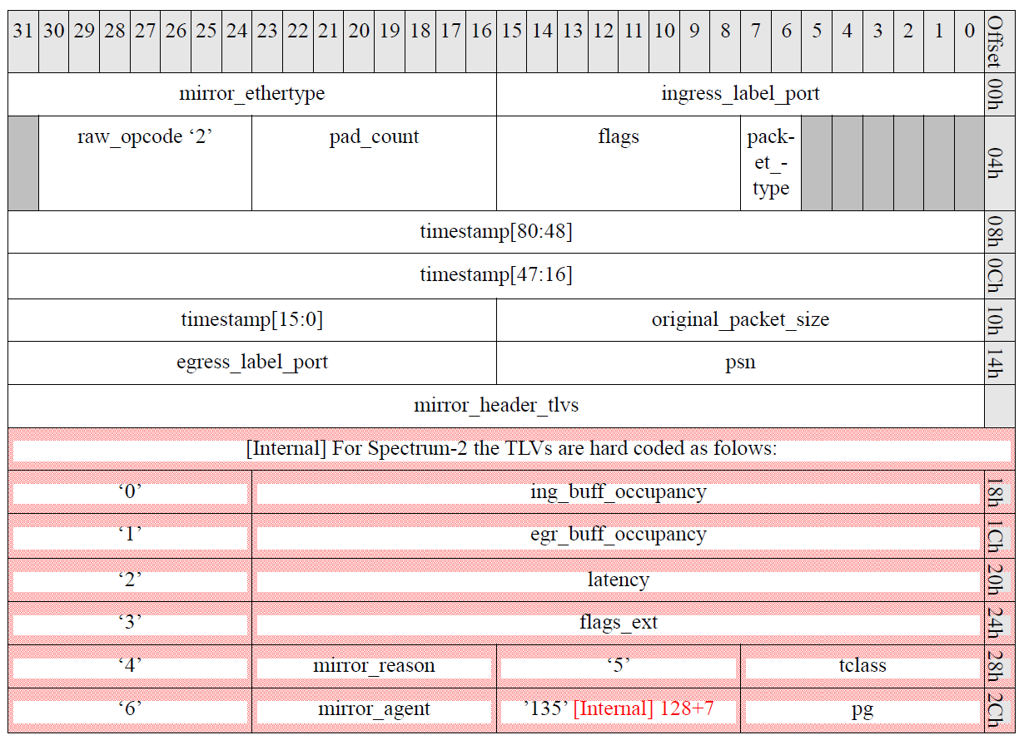
Project elements : Erspan & GRE
Notes:
The GRE session in our case used the Mellanox ERSPAN header, which wrapped every mirror packet with the following information.
We wrote a script to deparse the information received,, and specifically the tos value to help us differ the user flow from the congesting flow

Slide 10
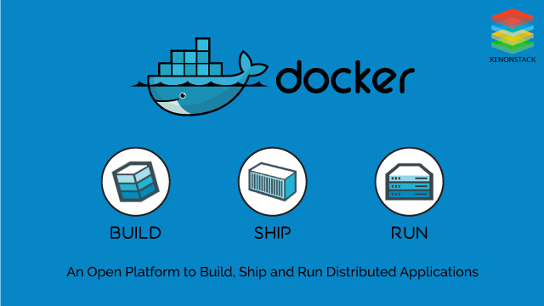
Project elements : Docker containers
Notes:
Docker container image is a lightweight, standalone, executable package of software that includes everything needed to run an application: code, runtime, system tools, system libraries and settings. We used 3 different docker containers running, for different uses
First one on a VM in our PCs for compiling our own p4 code. There we experienced on using p4 for the first time, and debugged our code.
Second docker on the switch receives the compiled output of our p4 code and loads it onto the data plane. Its our connection to the p4 on the switch.
There we also monitored our p4 program – the access list being added and removed, counters change as a match action occurred.
Last but not least – a P4RT shell docker on our collector linux machine. This docker has challenged us, as it required special configuration in order to allow it to create a P4RT friendly environment, and also to access the host’s physical interfaces in order to sniff the packets mirrored from the switch. On this docker, we run out program

Slide 11
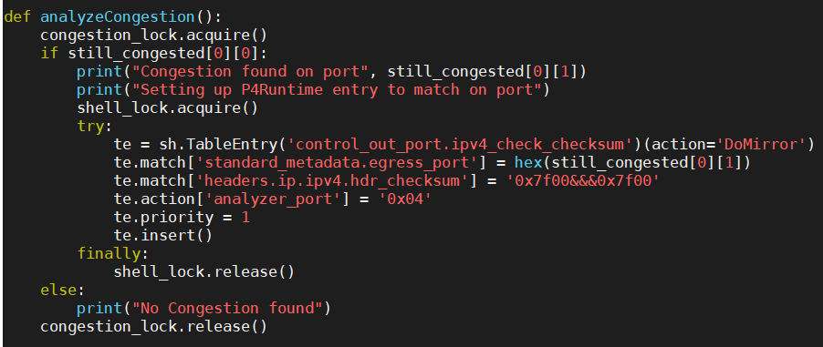
Project elements : P4 & P4Runtime
Notes:
P4 runtime is a frame work for runtime control of p4 targets, such as our spectrum switch, allowing us to dynamically add, remove & modify table entries
the P4 code can add match-action tables to the dataplane pipeline.
One of p4’s main feature, is the support for match-action tables. Match-action tables are mappings between agreed-on field values to a given set of actions. This means that we can look at certain fields in any packet that goes through the switch, and determine whether or not to perform an action on it. For example, in our case, we can mirror a packet with additional information, by inspecting the DSCP, egress port and checksum.
In order to make our program as dynamic as possible, we used an open source P4Runtime-shell in order to create new table entries that match the specific egress port that is congested.
#######################We used const entries to match on DSCP, and gRPC to match on egress port.

Slide 12
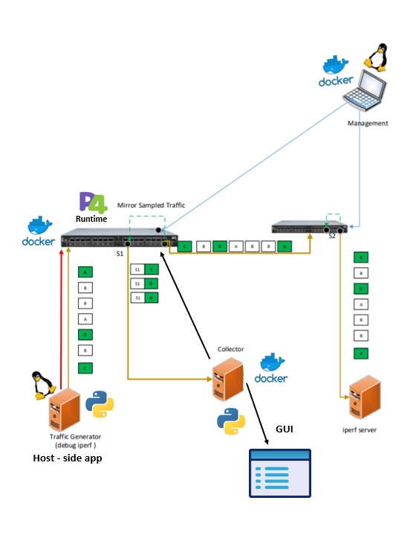
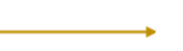
e
Workflow
A congestion event is occurring
Host app reports packet loss, causing the user to activate the debugger on the client side.
The debugger starts marking the packets of the relevant app (1 of Xth)
The marked packet reaches the switch, which matches it according to the DSCP value. Every matched packet is copied, encapsulated, and mirrored to the collector.
The collector uses this information to identify the user’s 5-tuple.
The collector dynamically adds a match-action using P4RT in order to match the congested traffic (by egress port)
The collector uses the information to differentiate the user’s flow from the congesting flow
The collector presents the information to the user
Set a new P4 match action
Notes:
How does it all work

Slide 13
Eventually
Notes:
This is our final product. Once the congestion was spotted and packets were marked, the user can activate the GUI to see all the wanted information.
The gui is written in python and gives the user the ability to get the relevant info
- show user path – displays the user’s 5-tuple (not the congesting flow)
- analyze congestion – if the program identifies a congested port, this button uses P4Runtim to add a table entry that matches dynamically on the congested port specifically
- export logs – creates a dated, ordered and clear summary of all the information shown by the GUI
- separate flows – displays all the different flows that have been detected on the congested port.

Slide 14
Demo

Slide 15

Challenges
Sending two different flows between the switches- the congested flow and the user flow.
Dynamically updating the p4 tables
Working with a new programming language that is still developing (not fully documented)
Unexpected changes of set-up
Layer 2 configuration on ONYX Switch
Docker usage and adaption to the environment
Notes:
As every project, we have had a lot of challenges along the way. Some were expected, and some were not.
Going in we new that p4 language is new and innovating, one of the things that drew us to this project. Lack of online info and documentation made working with it challenging and educating. We appreciate Alan’s help and guidance on this matter/
Docker usage was also new to us. Combining different scripts, environments and HW components to work together dynamically was not always a simple task/
On the unexpected side
We handled a set-up change in the middle of the project because of the lack of the second switch due to corona virus influences. We had to do a lot of changes in our set up, requiring a unique a-symatric layer 2 configuration., we also had to change code that was already compiled and deployed.
Speaking of corona- working from far with no physical access to the set up and the lab was also not always easy while working on a project of this type. Required a long distance assistance- mostly on Itzik’s expense.

Slide 16
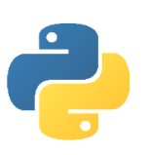
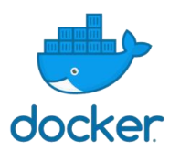

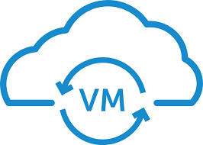

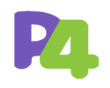
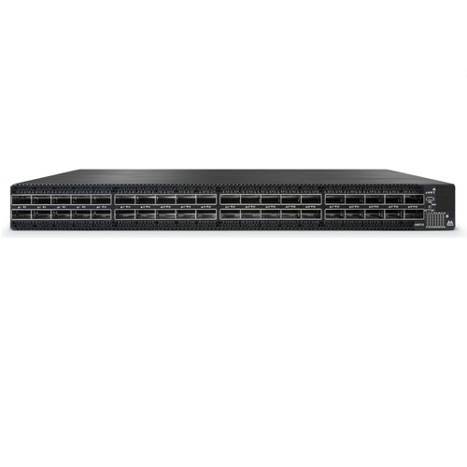
Acquired knowledge
Notes:
A lot of work on linux which was our main platform and python with which we wrote our scripts.
We now know how to work with different types of docker containers, and master the p4 programming.
We Got familiar with Mellanox switches

Slide 17

Plans for the future
Improve the project to work on a larger,
more sophisticated set up
Make the application self-triggered
Add a dynamic control over the
congestion’s threshold
Notes:
We have a lot of ideas on how to build upon and expand the project , with improvements and adaptations to a more complicated environment.

Slide 18
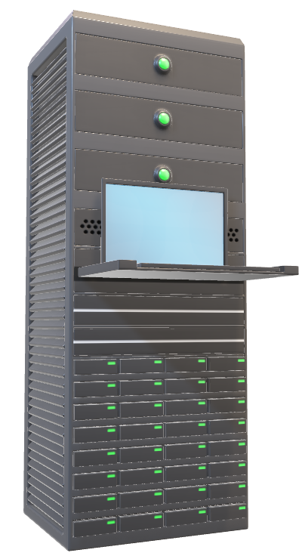
Thank You!

